Slide 1
Sports Data Operator
Excel VBA Analysis conducted by:
Colleen O'Leary, Andrew Lin, Chidera Ndukwe, John Papas, and Lucas Palmer

Slide 2
Why Excel VBA?
To minimize errors and data entry by hand is inefficient
To program everything with data visualizations
To identify and pull-out data with ease
It is simplistic
Every growth within a sector requires more time and data management, and it is harder to keep track

Slide 3
Objectives
To achieve the goal, we are looking into analyze the many different relationships in the world of sports data
Revenue
Population
State
Income
These are just examples and/or data we took to analyze the situation and what the stakeholders/clients want to know, so we can make that decision while informing cross-functional teams.

Slide 4
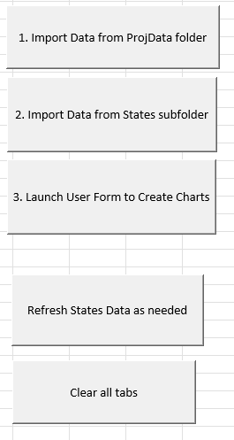
Macro Buttons for this Analysis

Slide 5
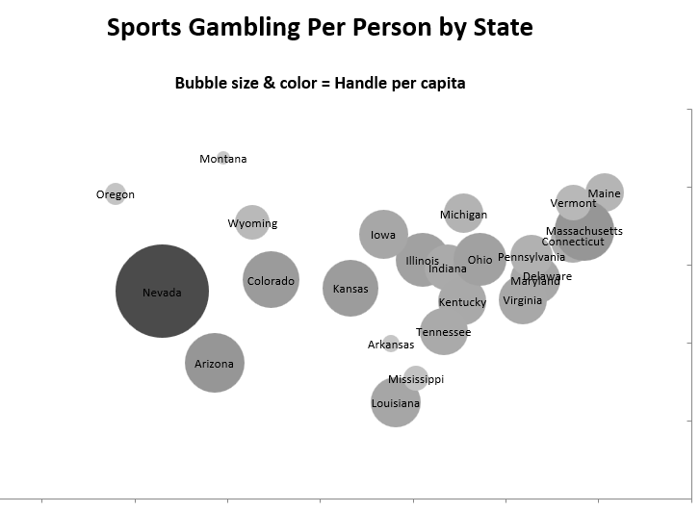
Sports Gambling Per Person by State

Slide 6
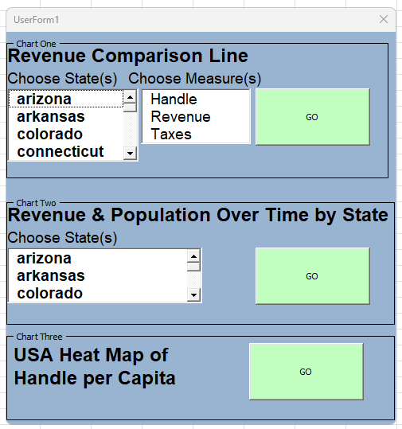
UserForms

Slide 7
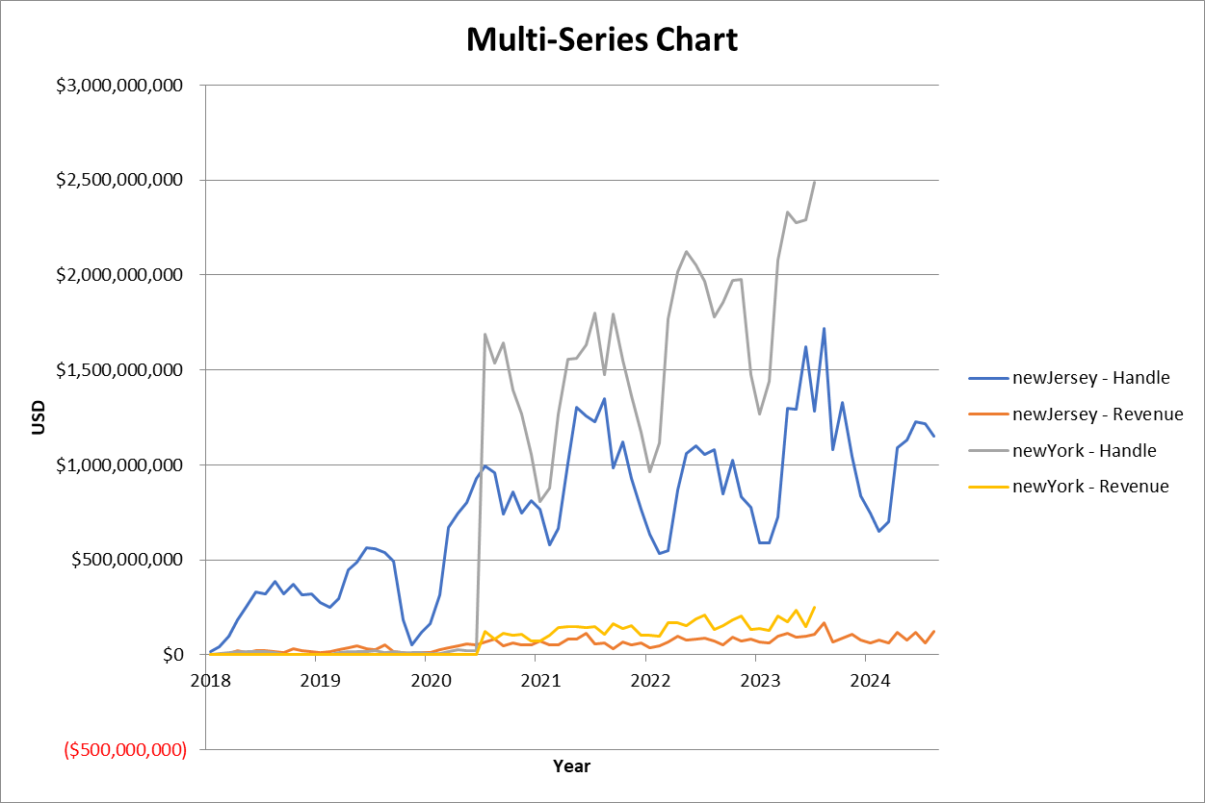
Data Visualizations

Slide 8
Thank you! Any Questions?

